Slide 1
Proactive Churn Prediction
& Retention Platform
Team Name: Churn Busters
Team Members:
L. Sarath Sai Kiran
K. Satish Reddy
T. Chandra Moulika
K. Tejaswini
M. Nithya
P. Keerthi Rani

Slide 2



Why Current Systems Fail
PROBLEM
STATEMENT
No early Churn Detection
Misses critical warning signs before customers churn.
4–6%
Customer data is scattered
Data silos prevent a complete view of customer view of customer behaviour.
Monthly Churn Rate
"85% of customers have already
decided before teams reach out."
Manual retention process
Reactive and time consuming-hard to scale or personalize.

Slide 3



Solution Overview
How the Platform Works
2
3
Automated retention workflows
AI-based churn prediction
Centralized customer data
All customer data from CRM, billing, support and product usage is unfilled in one platform for a 360’ customer view.
Automated alerts and personalized outreach via email, Slack, and tasks help engage at-risk customers and improve retention at scale.
AI models analyze customer behaviour, usage and signals to predict churn risk early with high accuracy.
Predict · Personalize · Automate · Retain

Slide 4






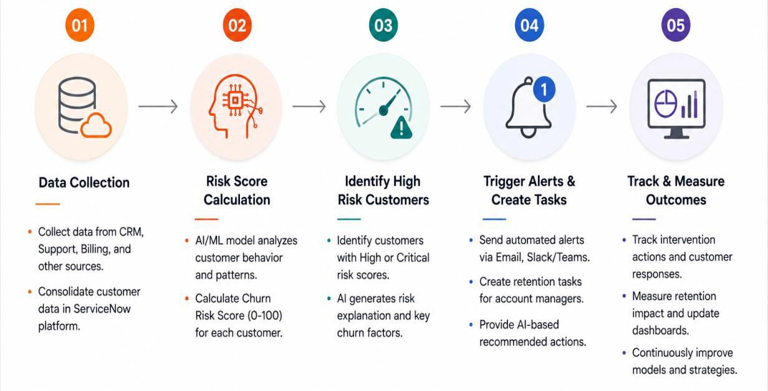
Key Features & Workflows
Churn Risk Score Prediction
AI Risk Explanation
Personalized Retention
AI models analyze behaviour
Gen AI explains key factors behind the risk score simple.
AI suggest next best actions.
Automated alerts & notifications
Dashboards & Reports
Workflow Automation
Real time dashboards, APIs reports to monitor and churn retention.
Real time alerts via Email, Slack.
Automated tasks, follow-ups assigned with zero manual effort.

Slide 5

Thank You
Thank You!
Our Team
Member 1 · ServiceNow Admin & Platform Lead
Member 4 · Integration Developer
Member 2 · Backend Dev & Business Rules
Member 5 · Dashboard & Reporting
Member 3 · AI Engineer
Member 6 · Documentation & QA
Key Learnings
End-to-end ServiceNow platform architecture — from tables to AI scoring
Practical ML model deployment using Predictive Intelligence
GenAI prompt engineering for retention recommendation systems
Agile 7-day sprint delivery with 6-member cross-functional team
Proactive Churn Prediction & Retention Platform

